Slide 1

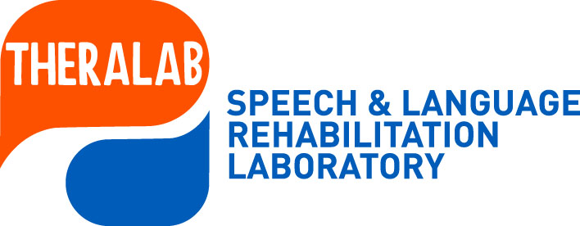

Kakia Petinou, Theodora Papastefanou
Cyprus University of Technology
School of Health Sciences
Department of Rehabilitation Sciences
Speech Sound Disorders: The importance of speech inconsistency
The 5th International Symposium on Monolingual and Bilingual Speech (ISMBS 2025) June 16-18, 2025 Chania, Crete
Notes:
Thank you very much for accepting our study on targeting speech intelligibility using phonologically similar targets: a single-case study of dialectal Cypriot-Greek-speaking child with speech sound disorders.

Slide 2



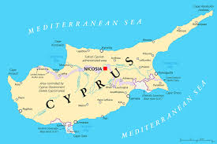

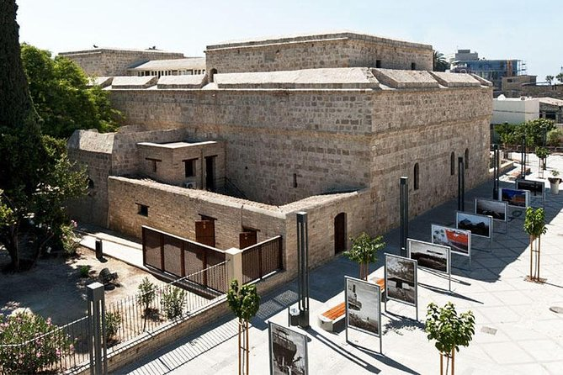

CUT

Slide 3
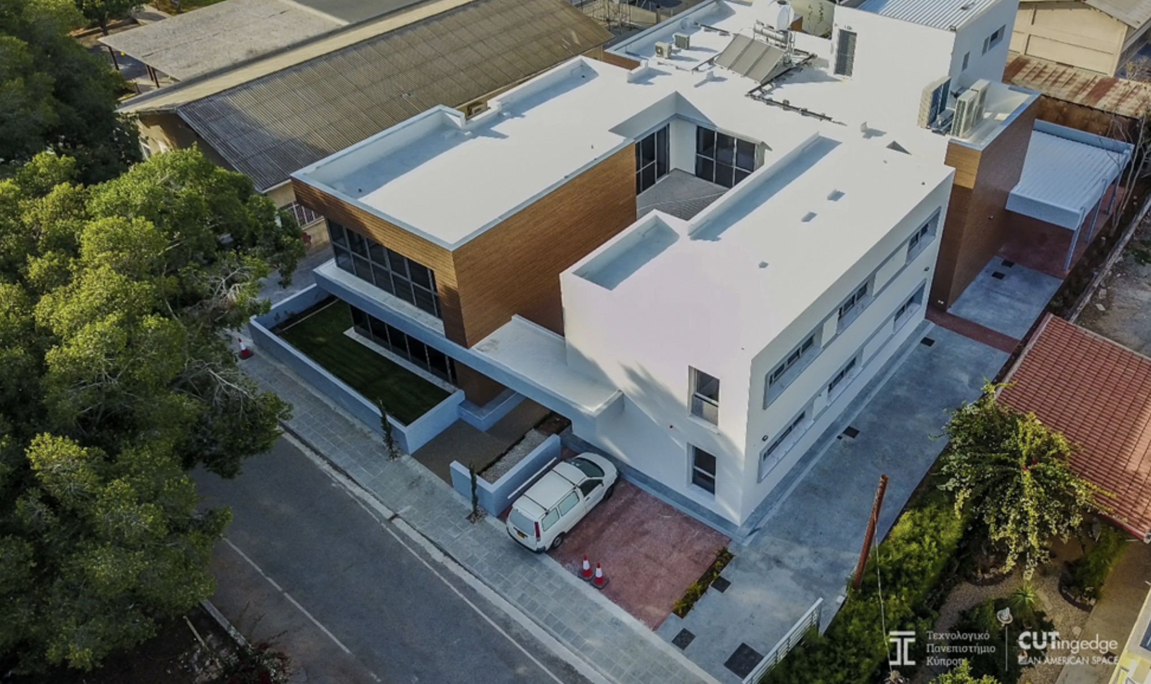

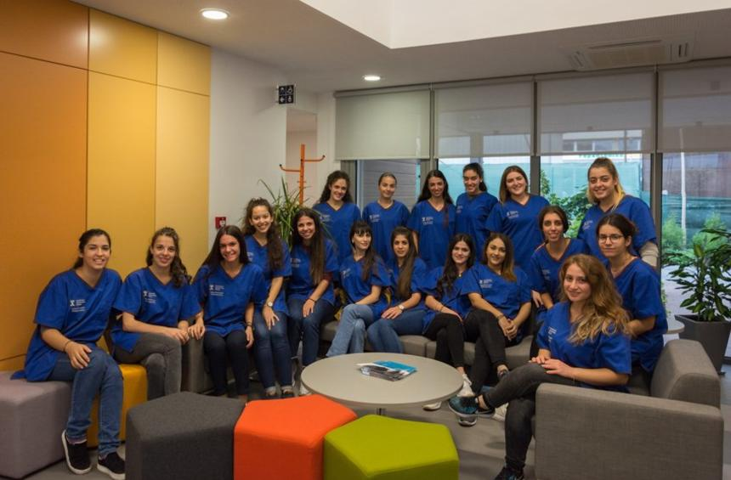
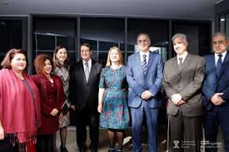
University rehabilitation clinic and research laboratories

Slide 4
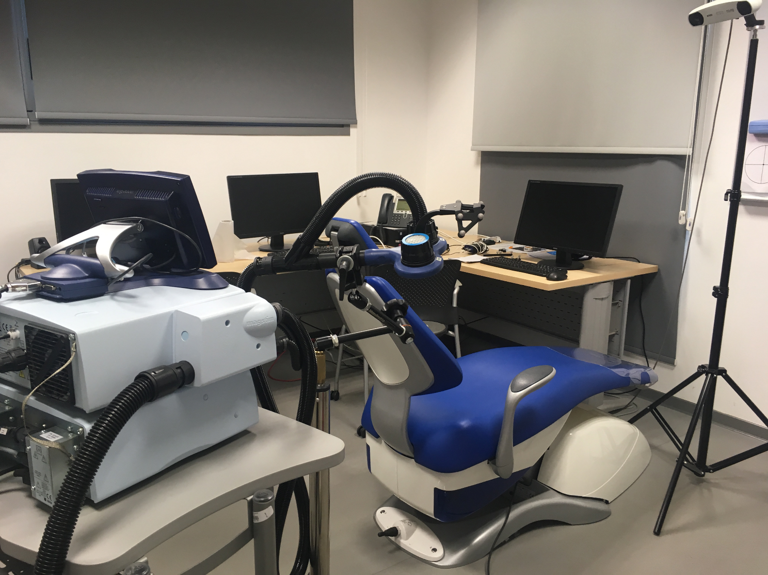
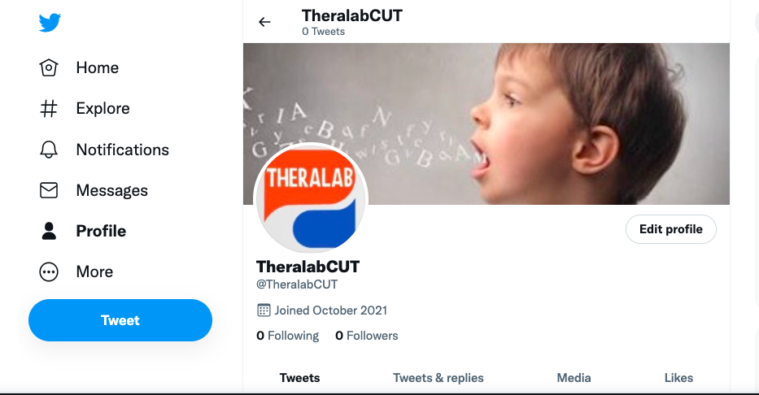

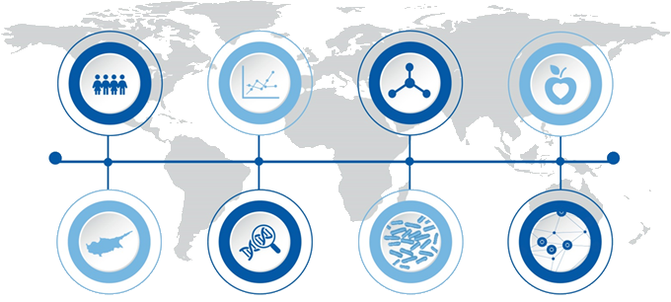
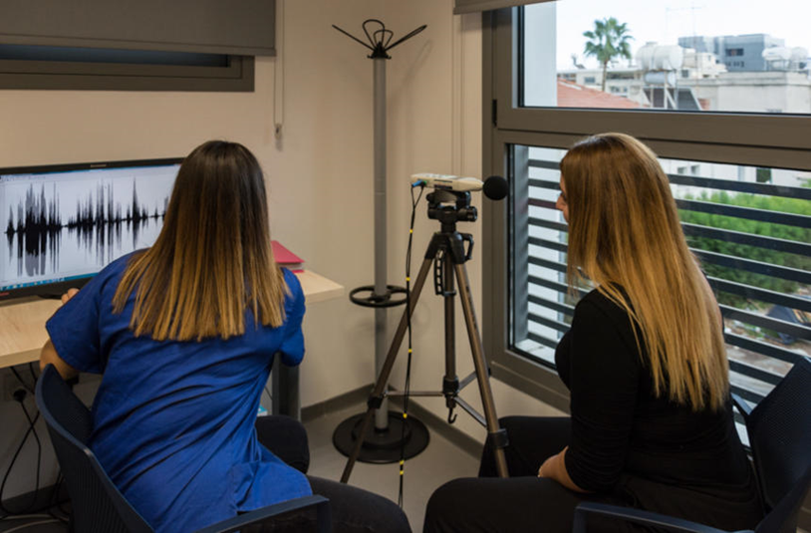
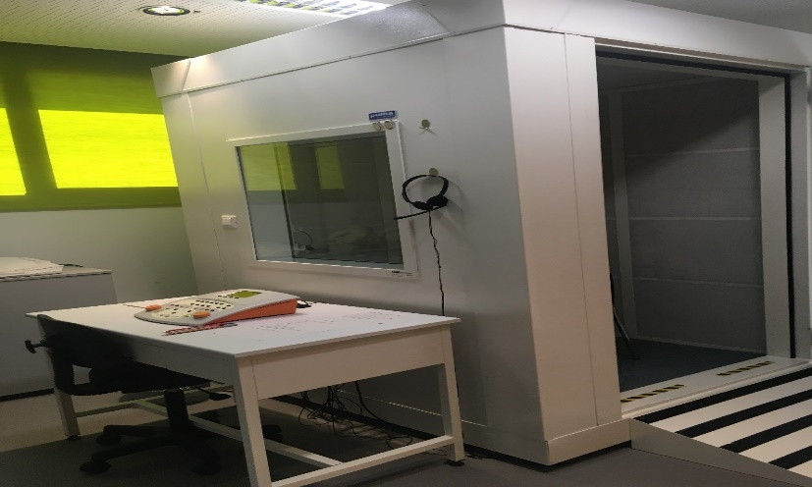

Slide 5

Umbrella research project
LINGUISTIC OUTCOMES GROWTH OF SPEECH [LOGOS]
Funding secured 200,000 EURO (2013-2022)
Linguistic Outcomes & Growth Of Speech (LOGOS)-sub projects
Assessing Parameters Expressive Communication Targets ASPECT
Promoting Articulatory Motor Expression Tx PAME
Τesting Of Phonological Skills TOPS
Gainng Articulatory Motor Expression GAME
Gaining Articulatory Intelligibilty GAIN
Transdiagnostic Speech Expression TRASE
Profiling Early Diagnostic Indexes PEDI

Slide 6
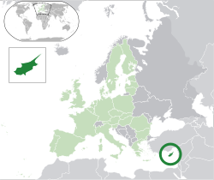
Cyprus Discrete Bilectalism (Rowe & Grohmann, 2013)
Cypriot Greek (CG) as a dialectal variety of Standard Modern Greek (SMG) :
Mainly spoken in Cyprus
Preschool/kindergarten mainly speak CG and are exposed more intensively to SMG during school years
SMG used in Government offices
Television
Discreet Bilectal (Rowe & Grohmann, 2013)
CG contains phonemes and phonological rules that are similar but also slightly different from SMG (Petinou & Armostis, forthcoming issue, McLeod et al., 2025) .
Notes:
The linguistic variety investigated in this study is CG, a variety of Standard Modern Greek (SMG) [39,40]. Although CG is the everyday variety used by most speakers on the island of Cyprus, SMG is used in specific official settings such as school classes and the media. At the same time, CG dominates in informal everyday communication. The Greek-speaking populace of Cyprus is diglossic in that CG is the vernacular form (low variety) used in everyday communication, whereas SMG (as the high variety) is used in educational settings, government bodies, and the media. Recent reports propose the emergence of a dialectical continuum of CG with an emerging "Koine" or "Urban" form of CG [41]. Its consonantal phonetic inventory contains 31 singletons, most of which have geminate counterparts. There are bilabial, labio-dental, dental/alveolar, palatal and velar phonemes. Regarding manner of articulation, there are stops, fricatives, affricates, nasals, liquids, and glides. The liquid segment /r/ is trilled. In CG, voiced stops are pre-nasalized, with voiceless cognates being either unreleased or aspirated. The /n/ and /s/ may also occur in the word-final position. CG contains post-alveolar fricative and affricates and geminates (double segments) differing from singletons mainly in duration (Armostis, 2009).

Slide 7
Speech Sound Disorders (SSD)
Definition: SSDs involve difficulties in producing speech sounds correctly, affecting speech intelligibility.
Common in early childhood, affects communication, social skills, and academic performance (Dodd et al., 2014).
Prevalence: Approximately 7% of children may experience SSDs, with a higher prevalence in bilingual or dialectal populations (Grech, 2019).
SSD can result in unintelligible speech and communication difficulties
Phonological intervention is key in addressing speech sound errors.
Notes:
SSDs involve difficulties in producing speech sounds correctly, affecting speech intelligibility.
Common in early childhood, affects communication, social skills, and academic performance

Slide 8
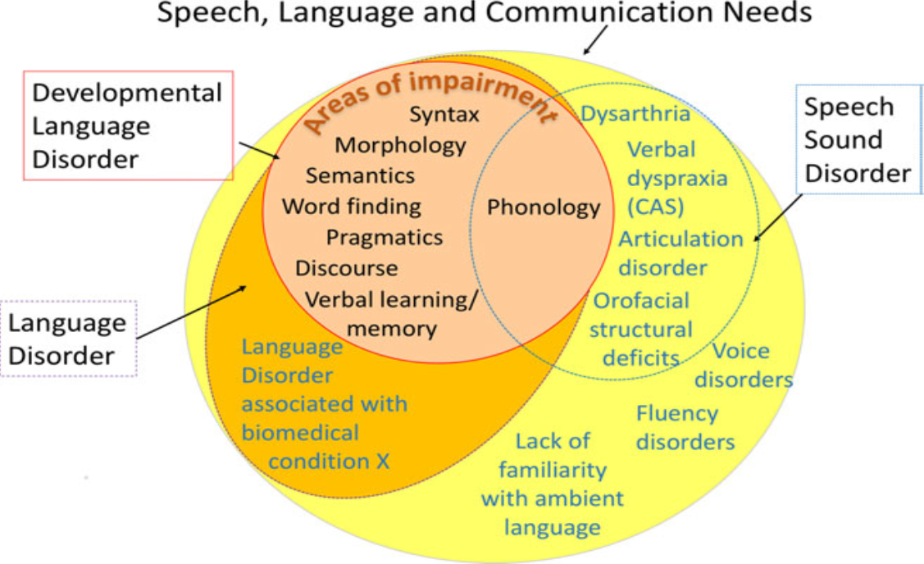
Catalise Delphi Consensus Study (Bishop , 2016)

Slide 9
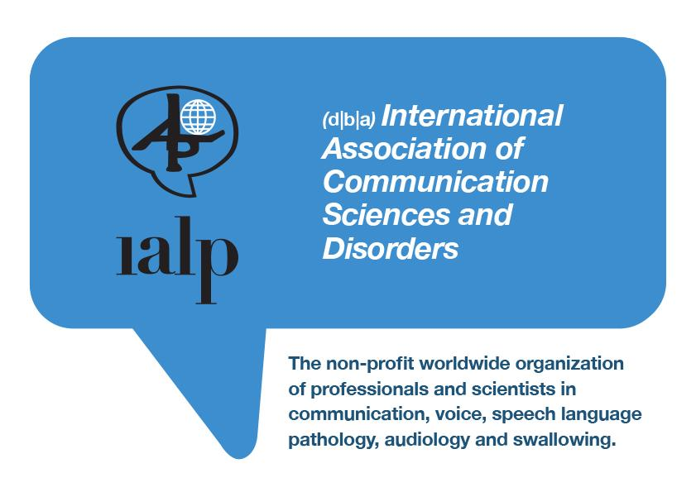
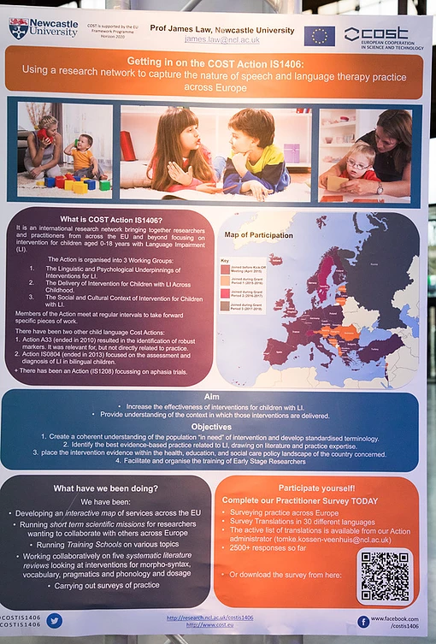
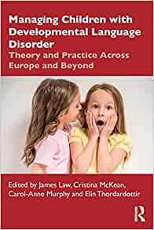

IALP & COST ACTION
YOUTUBE CHANNEL ASD COMM
https://m.youtube.com/watch?v=8sLUWsOedAI

Slide 10
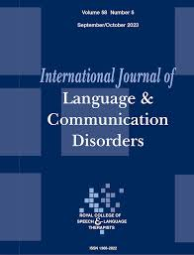
Impetus of the investigation
What’s in the name:
Petinou-Loizou K, Ttofari K, Filippou E. What is in a name: Taxonomy of speech sound disorders from a cross-linguistic perspective. Int J Lang Commun Disord. 2024 Nov-Dec;59(6):2123-2130. doi: 10.1111/1460-6984.13092. Epub 2024 Jul 19. PMID: 39031175.
SLPs do not implement or use a Taxonomy system in the analysis of SSD profiles
Compromises differential Diagnosis and Selection of Optimal Intervention Framework
Successful outcomes
Notes:
In response to the call for papers under the theme "What is in a name," proposed by the Scientific Child Speech Committee of the International Association of Communication Sciences and Disorders (IALP), the current paper discusses taxonomy and its relation to speech sound disorders (SSD) from a cross-linguistic perspective. The authors draw from international theoretical and clinical research, which underscores the importance of taxonomy systems in SSD. The current paper stresses the importance of the contribution to differential diagnosis and prognosis of children with protracted speech profiles based on taxonomy profiles and systems for SSD. The advantages and shortcomings of taxonomy in SSD are also discussed from a cross-linguistic context.

Slide 11
Why Taxonomy and Inconsistency matter? Research Gap
Why Taxonomy and Inconsistency Matter?
  Inform evidence-based practice,
  Bear translational value for differential diagnosis,
  Guide the selection of the optimum intervention
Significance of Study:
Limited data on cross-language taxonomy profiles despite the plethora of developmental data and SSD features.
Exploring the role of phonological inconsistency.
  Addressing issues related to SSD Taxonomy and Inconsistency as per Error Types (Dodd, 2023; Petinou et al., 2024)
Notes:
Therefore, SSD affects a child's ability to produce sounds correctly. Phonological intervention is key in addressing speech sound errors.
Importance of phonological density and word-level characteristics in intervention. Significance of Study: Limited studies on Cypriot Greek-speaking children with SSD. Exploring the role of phonological error types via inconsistency, given that Dodd’s model, adopted here, includes two subtypes of Phonological Disorders differentiated on the presence or absence of phonological inconsistency.

Slide 12
Differential Diagnostic Classification System (DDCS) categorizes Speech Sound Disorders (SSDs)
Phonological Delay:
  A delay compared to typical developmental milestones, but they are still using typical phonological processes.
Consistent Deviant Phonological Disorder:
  The use of non-developmental or atypical phonological processes, indicating an impaired understanding of the target phonological system.
Inconsistent Deviant Phonological Disorder:
  Variable productions of the same word, with some productions being more accurate than others, and the use of inconsistent phonological processes.
Childhood Apraxia of Speech (CAS):
  Motor speech disorder in planning and coordinating the complex movements needed for speech (inconsistency plus prosodic and pause features)
Notes:
Dodd's 2014 Differential Diagnostic Classification System (DDCS) categorizes Speech Sound Disorders (SSDs) into several subtypes, including articulation disorder, phonological delay, consistent deviant phonological disorder, inconsistent deviant phonological disorder, and Childhood Apraxia of Speech (CAS). This system is based on a psycholinguistic model of speech production and provides a framework for understanding the different ways in which children can experience SSDs. ) Dodd, B. Differential Diagnosis of Pediatric Speech Sound Disorder. Curr Dev Disord Rep 1, 189–196 (2014). https://doi.org/10.1007/s40474-014-0017-3

Slide 13
The current study
The aim was twofold:
  (a) to measure the presence of inconsistency and
  (b) to map error patterns
Exploratory examination-pilot

Slide 14
Participants
Included two groups of bilectal CG-speaking children ages 4;6-7;0 years (M= 6 , SD= 1.05)
Recruited from several SLP centers and the CUT rehabilitation Clinic
Some children were enrolled in therapy (no more than 2 months before the onset of the study)
Caregivers signed a written consent (Cyprus National Bioethics Committee Approval, 2021, Protocol number 41).

Slide 15
Participants [2]
Children with a diagnosis of SSD (n=9) (Cyprus Phonology Test, Petinou in progress)
Children with Typical Development (TD) (n=9)
Phonological Deficits:
  Limited phonetic inventory, difficulties with consonant clusters, and vowel production errors.
  Impaired intelligibility and sound substitution patterns
  Intelligibility Context Scale-Greek (average number 1-2)

Slide 16
Methodology and Procedures
Inconsistency was examined with the use of a 40-word probe list consisting of trisyllabic and multisyllabic targets
The stimuli were designed according to Dodd’s DEAP test (Personal Communication).
Converted to PowerPoint pictures
Targets were elicited three times across one experimental session
Blocks of trials were presented randomly, with a time delay between each block presentation

Slide 17
Methodology and Procedures [2]
Productions were transcribed in IPA and were coded using a binary system
0 = no inconsistency, 1 = presence of inconsistency (variable productions across at least two out of the three times)
Coding and measurement reliability across 10% of the productions was approximately 90%

Slide 18

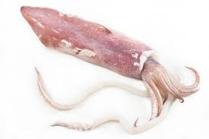

Stimuli - Example
/kala’maɾi/
‘squid’
/ka’laΘaci/
‘basket/
/kala’maci/
‘straw’

Slide 19
Examples Cognate stimuli 3-syllables; multisyllabic
Probe | 1 | 2 | 3 | SCORE
[kaˈmila] | [aˈmila] | [gaˈmila] | [laˈmila] | 1
[doˈmata] | [moˈmata] | [maˈmata] | [kaˈmata] | 1
[baˈnana] | [na'nana], | [naˈnana] | [naˈnana] | 0
[kanguˈro] | [atoˈro] | [tantuˈro] | [anguˈro] | 1
[ˈp:it:a] | [ˈita] | [ˈmita] | [ˈtita] | 1

Slide 20
Results [1] Group Comparison – Inconsistency Scores
Group | Mean (%) | SD | Min–Max
SSD (n=9) | 70.5 | 16.7 | 38–96
TD (n=9) | 1.9 | 2.7 | 0–7.5
Statistical Test: Mann-Whitney U = 81.0, p < 0.001 (Significant)
Notes:
Interpretation
Children with Speech Sound Disorders (SSD) show substantially higher and more variable inconsistency compared to their typically developing (TD) peers.
This supports the study’s hypothesis that inconsistency is a key marker in distinguishing SSD subtypes, particularly those with inconsistent phonological disorder (IPD) or planning deficits (e.g., CAS).
The Mann-Whitney result is statistically significant (p < 0.001), confirming that children with SSD exhibit significantly higher inconsistency in speech production than their typically developing peers. This supports the diagnostic relevance of inconsistency measures.
Children with SSD (n=9) showed significantly higher inconsistency (M = 70.5%) than TD peers (M = 1.9%, p < 0.001).
Despite the small sample size, the effect is strong and statistically robust. Inconsistency appears to be a key marker in distinguishing SSD subtypes.
Dodd's 2014 Differential Diagnostic Classification System (DDCS) categorizes Speech Sound Disorders (SSDs) into several subtypes, including articulation disorder, phonological delay, consistent deviant phonological disorder, inconsistent deviant phonological disorder, and Childhood Apraxia of Speech (CAS). This system is based on a psycholinguistic model of speech production and provides a framework for understanding the different ways in which children can experience SSDs.

Slide 21
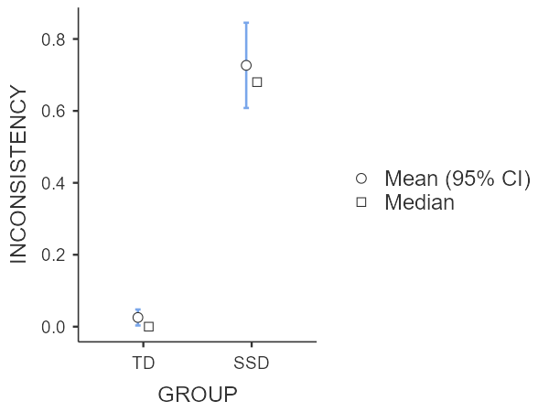
Figure 1
Notes:
Interpretation
Children with Speech Sound Disorders (SSD) show substantially higher and more variable inconsistency compared to their typically developing (TD) peers.
This supports the study’s hypothesis that inconsistency is a key marker in distinguishing SSD subtypes, particularly those with inconsistent phonological disorder (IPD) or planning deficits (e.g., CAS).
The Mann-Whitney result is statistically significant (p < 0.001), confirming that children with SSD exhibit significantly higher inconsistency in speech production than their typically developing peers. This supports the diagnostic relevance of inconsistency measures.
Children with SSD (n=9) showed significantly higher inconsistency (M = 70.5%) than TD peers (M = 1.9%, p < 0.001).
Despite the small sample size, the effect is strong and statistically robust. Inconsistency appears to be a key marker in distinguishing SSD subtypes.
Dodd's 2014 Differential Diagnostic Classification System (DDCS) categorizes Speech Sound Disorders (SSDs) into several subtypes, including articulation disorder, phonological delay, consistent deviant phonological disorder, inconsistent deviant phonological disorder, and Childhood Apraxia of Speech (CAS). This system is based on a psycholinguistic model of speech production and provides a framework for understanding the different ways in which children can experience SSDs.

Slide 22
Figure 2
Notes:
Interpretation
Children with Speech Sound Disorders (SSD) show substantially higher and more variable inconsistency compared to their typically developing (TD) peers.
This supports the study’s hypothesis that inconsistency is a key marker in distinguishing SSD subtypes, particularly those with inconsistent phonological disorder (IPD) or planning deficits (e.g., CAS).
The Mann-Whitney result is statistically significant (p < 0.001), confirming that children with SSD exhibit significantly higher inconsistency in speech production than their typically developing peers. This supports the diagnostic relevance of inconsistency measures.
Children with SSD (n=9) showed significantly higher inconsistency (M = 70.5%) than TD peers (M = 1.9%, p < 0.001).
Despite the small sample size, the effect is strong and statistically robust. Inconsistency appears to be a key marker in distinguishing SSD subtypes.
Dodd's 2014 Differential Diagnostic Classification System (DDCS) categorizes Speech Sound Disorders (SSDs) into several subtypes, including articulation disorder, phonological delay, consistent deviant phonological disorder, inconsistent deviant phonological disorder, and Childhood Apraxia of Speech (CAS). This system is based on a psycholinguistic model of speech production and provides a framework for understanding the different ways in which children can experience SSDs.

Slide 23
Results [2] Qualitative Error Patterns (SSD Group)
Variable Productions (IPD hallmark)
Backing (e.g., /t/ → /k/) → Severe in MIX
Vowel Changes → “falana” → “felela”
Syllable Simplification → Cluster and structure omissions
Default Sounds → Frequent use of /fa/, /ma/
Stress Shifts → Suggesting motor planning issues
Notes:
Dodd's 2014 Differential Diagnostic Classification System (DDCS) categorizes Speech Sound Disorders (SSDs) into several subtypes, including articulation disorder, phonological delay, consistent deviant phonological disorder, inconsistent deviant phonological disorder, and Childhood Apraxia of Speech (CAS). This system is based on a psycholinguistic model of speech production and provides a framework for understanding the different ways in which children can experience SSDs.

Slide 24
Results [3] Qualitative Error Types
Error Patterns Observed (Qualitative)
Children with SSD—particularly those suspected of having Inconsistent Phonological Disorder (IPD) or Childhood Apraxia of Speech (CAS)—showed:
  Regressive assimilation
  Initial consonant deletion
  Cluster reduction
  Syllable omission
  Default sound substitutions
  Stress shifts and vowel assimilations
These errors suggest difficulties not only with phonological knowledge but also with speech motor planning.
Notes:
Dodd's 2014 Differential Diagnostic Classification System (DDCS) categorizes Speech Sound Disorders (SSDs) into several subtypes, including articulation disorder, phonological delay, consistent deviant phonological disorder, inconsistent deviant phonological disorder, and Childhood Apraxia of Speech (CAS). This system is based on a psycholinguistic model of speech production and provides a framework for understanding the different ways in which children can experience SSDs.

Slide 25
Results [3] Qualitative Error Types
Several patterns emerged:
Backing (noted in participant MIX):
  e.g., /t/ or /p/ becoming /k/ or /g/: “kaˈxami”, “kaˈgana”, “gaˈcija”
  Diagnostic for atypical processes, possibly CAS or severe IPD.
Vowel Assimilation:
  Seen in “ˈfalana, ˈlalala, faˈfala” or “faˈlana, feˈfela, faˈlana” → unpredictable vowel shifts.
  Suggests planning/programming deficits.
Syllable structure changes:
  Simplification of multisyllabic words: “koˈkaka, koˈmaka, koˈmati” → clear reduction and substitution.
  Points to motor-based inconsistencies, often tied to CAS.
Default Sound Use:
  Use of /fa/, /pa/, or /ma/ as generic fillers (e.g., “faˈfala”, “maˈmata”)—typical in IPD or CAS.
Stress Shifts:
  “ˈfanela, ˈfafela, faˈfela” or “feˈfeja, faˈfeja, faˈjoja” → shifting syllable prominence, a hallmark of CAS.
Notes:
Dodd's 2014 Differential Diagnostic Classification System (DDCS) categorizes Speech Sound Disorders (SSDs) into several subtypes, including articulation disorder, phonological delay, consistent deviant phonological disorder, inconsistent deviant phonological disorder, and Childhood Apraxia of Speech (CAS). This system is based on a psycholinguistic model of speech production and provides a framework for understanding the different ways in which children can experience SSDs.

Slide 26
Differential Diagnostic Classification System Categories
Inconsistency is a core feature of:
Inconsistent Deviant Phonological Disorder: characterized by different errors across repeated productions of the same word.
CAS: characterized by inconsistency plus motoric/prosodic disturbances like stress shift and abnormal pauses.
Most children with SSD present with inconsistency patterns
Within SSD profiles what core features allow a detailed taxonomy?
Which SSD features allow differentiation (vowel assimilations CAS)
Notes:
Dodd's 2014 Differential Diagnostic Classification System (DDCS) categorizes Speech Sound Disorders (SSDs) into several subtypes, including articulation disorder, phonological delay, consistent deviant phonological disorder, inconsistent deviant phonological disorder, and Childhood Apraxia of Speech (CAS). This system is based on a psycholinguistic model of speech production and provides a framework for understanding the different ways in which children can experience SSDs.

Slide 27
Diagnostic Implications
Based on DDCS Taxonomy:
Most SSD children: Inconsistent Phonological Disorder (IPD)
MIX (and possibly others): Features of Childhood Apraxia of Speech (CAS)
No evidence of Phonological Delay
Notes:
Dodd's 2014 Differential Diagnostic Classification System (DDCS) categorizes Speech Sound Disorders (SSDs) into several subtypes, including articulation disorder, phonological delay, consistent deviant phonological disorder, inconsistent deviant phonological disorder, and Childhood Apraxia of Speech (CAS). This system is based on a psycholinguistic model of speech production and provides a framework for understanding the different ways in which children can experience SSDs.

Slide 28
Overall findings
Confirm IPD as a distinct diagnostic category
Align with Dodd’s framework that atypical, variable errors are diagnostic markers for planning/programming impairments
Suggest that inconsistency scoring tools could help guide clinical interventions and subtype classification
TD children and those with IPD had different quantitative and qualitative error profiles, confirming IPD as a diagnostic category of SSD.
Words with more phonemes, syllables, and consonant clusters were vulnerable to inconsistency, but their frequency of occurrence had no effect
Within the SSD category, children with suspected planning/programming deficits (CAS) presented with more vowel assimilations and stress shift across productions
Notes:
Dodd's 2014 Differential Diagnostic Classification System (DDCS) categorizes Speech Sound Disorders (SSDs) into several subtypes, including articulation disorder, phonological delay, consistent deviant phonological disorder, inconsistent deviant phonological disorder, and Childhood Apraxia of Speech (CAS). This system is based on a psycholinguistic model of speech production and provides a framework for understanding the different ways in which children can experience SSDs.

Slide 29
Conclusion
Great variability in inconsistency within the SSD category
Not a non-all-none phenomenon
Inconsistency as a robust pattern of SSD
Need to focus on individual profiles as well as common patterns
‘Tool’ of measures important in production
Not only as a diagnostic pattern but also as a guide for intervention

Slide 30
Future directions
Does inconsistency decrease after intervention with therapy?
Does it differentiate SSD subtypes?
What are the most vulnerable words? (specificity and sensitivity)
How does inconsistency correlate with connected speech and ICS?
How does it surface cross-linguistically?
Similar sounding words across languages

Slide 31


Slide 32
Differential Diagnostic Classification System (DDCS) categorizes Speech Sound Disorders (SSDs) [2]
To cite this article: Barbara Dodd, Beth McIntosh, Sharon Crosbie & Alison Holm (2024) Diagnosing inconsistent phonological disorder: quantitative and qualitative measures, Clinical Linguistics & Phonetics, 38:5, 453-476, DOI: 10.1080/02699206.2023.2224916
Assessment determined the proportions of words said consistently (i.e. the same across productions: all correct or with the same error) or inconsistently (i.e. differently across productions: at least one correct and one error or different errors in productions). Qualitative analyses examined error types and explored the effect of target words’ characteristics on inconsistency. Children with IPD produced 52% of words with different errors. While 56% of all phoneme errors were developmental (age appropriate or delayed), atypical errors typified inconsistency: default sounds and word structure errors. Words with more phonemes, syllables and consonant clusters were vulnerable to inconsistency, but their frequency of occurrence had no effect
TD children and those with IPD had different quantitative and qualitative error profiles, confirming IPD as a diagnostic category of SSD. Qualitative analyses supported the hypothesised deficit in phonological planning of words’ production for children with IPD.
Notes:
Dodd's 2014 Differential Diagnostic Classification System (DDCS) categorizes Speech Sound Disorders (SSDs) into several subtypes, including articulation disorder, phonological delay, consistent deviant phonological disorder, inconsistent deviant phonological disorder, and Childhood Apraxia of Speech (CAS). This system is based on a psycholinguistic model of speech production and provides a framework for understanding the different ways in which children can experience SSDs.

