Slide 1


Computational Investigation of Dwellings’ Foundations as a GHE in Mediterranean Climate
7th International Conference on "Energy, Sustainability and Climate Change"
Lazaros Aresti, Paul Christodoulides, Christos Makarounas,
Lazaros Lazari and Georgios Florides

Slide 2
Shallow Geothermal Energy
used for space heating and cooling.
In all cases, heat is extracted from or rejected into the ground at a specific depth (different for each case).
GSHPs extract or reject heat to the Earth via a network of tubes. Although GHEs have significantly higher performance over conventional air-to-air heat exchanger systems they are not widely used due to their higher installation cost and limited availability.

Slide 3
Ground Heat Exchanges types

Slide 4
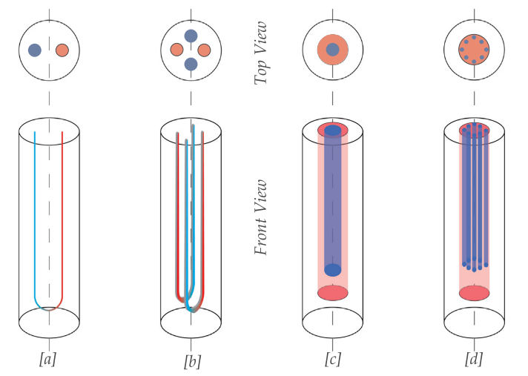
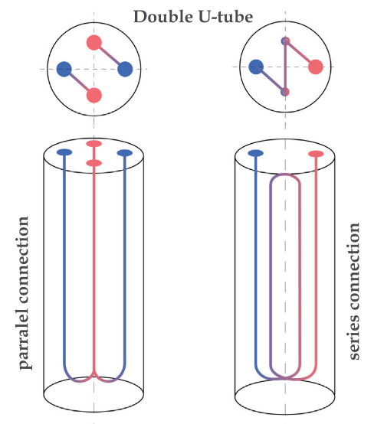
Vertical borehole GHEs
U-tube
Double U-tube
Simple Coaxial
Complex coaxial

Slide 5
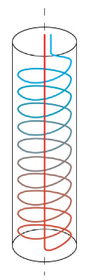
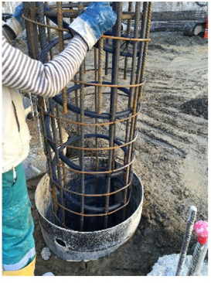
Spiral GHE and Energy piles
Typically, foundation or energy piles have a
  diameter between 0.4 and 1.5 m, and
  depths of 10–40 m
The piles are made of reinforced concrete, while the probes are made of High Density Polyethylene (HDPE), and are connected to the steel frame of the piles through plastic brackets.
The pipes can be arranged in different geometric configurations (single, double or triple U-shaped, W-shaped, spiral coil).

Slide 6
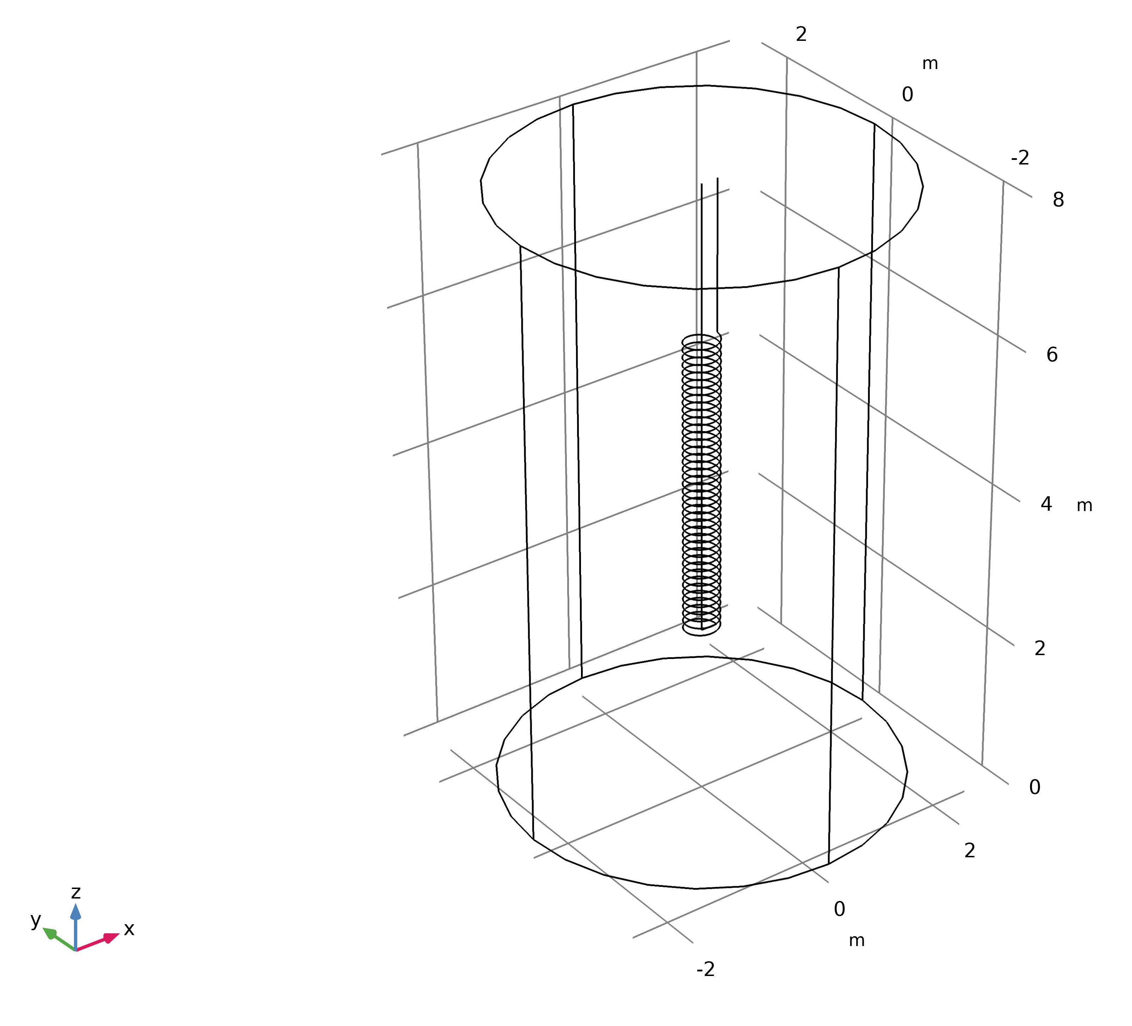
Computational Model overview
General model of Ground Heat Exchanger with FEM
Model constructed using COMSOL Multiphysics v5.5
The three-dimensional model consists of the spiral pipe domain, the grout domain (borehole, well or pile foundation) and the ground domain with its sublayers
Model constructed using an existing experiment with the following Parameters:
  Pipe radius: 0.014m
  Pipe thickness: 0.003m
  Borehole Depth: 4m
  Borehole diameter: 0.45m
  Spiral pitch: 0.1m
  Volumetric flow rate: 15 L/min
  Inlet temperature: 50.7ºC
  Initial temperature: 18ºC

Slide 7

Governing Equations
convection-diffusion equation
Heat Transfer in Pipes
where ρ is the density [kg m⁻³],
T is temperature [K],
t is time [s],
Cp is the specific heat capacity at constant pressure [j kg⁻¹ K⁻¹],
u is the velocity [m s⁻¹],
ue_{t} is the tangential velocity [m s⁻¹],
Q is the heat source [W m⁻³],
Q_{wall} is the pipes wall heat tranferer and is expressed as $Q_{wall}={\left(hZ\right)}_{eff}(T_{ext}−T)$,
hZ is the effective heat transfer coefficient
q is the Fourier’s law of heat conduction, $q=−k∇T$
k is the thermal conductivity [ W m⁻¹ K⁻¹]
A is area [m²] , and
f_{D} is the Darcy’s friction

Slide 8
Computational Model Validation
Conditions:
  Pipe radius: 0.014m
  Pipe thickness: 0.003m
  Borehole Depth: 4m
  Borehole diameter: 0.45m
  Spiral pitch: 0.1m
  Volumetric flow rate: 15 L/min
  Inlet temperature: 50.7ºC
  Initial temperature: 18ºC
  Difference in the initial hours is due to:
  Only average inlet temperature is provided by the authors
  Volume flow rate could be varied until stabled

Slide 9
Spiral Pitch effect
HTR decreases with the increase of spiral pitch
Outlet temperature increases with the increase of pitch
On long term simulations, difference of the spiral pitch with outlet temperature decreases

Slide 10
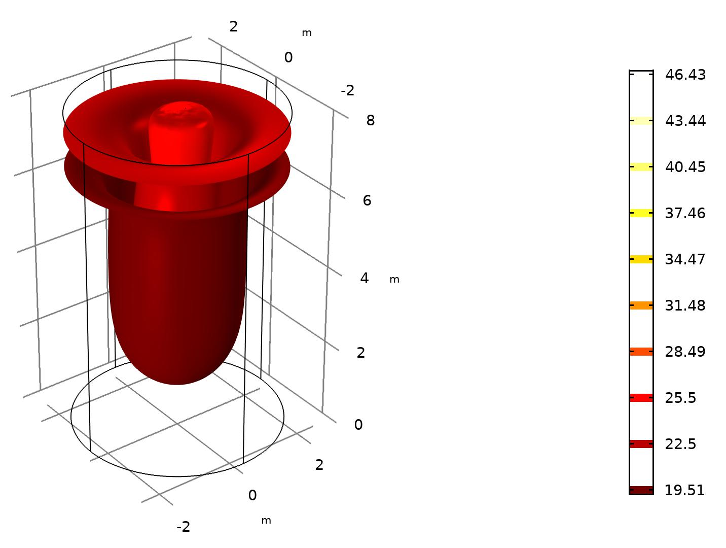
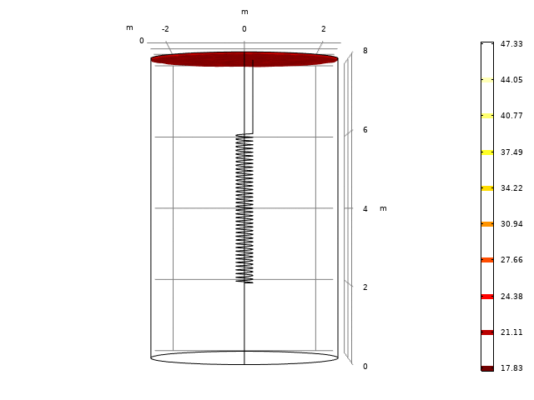
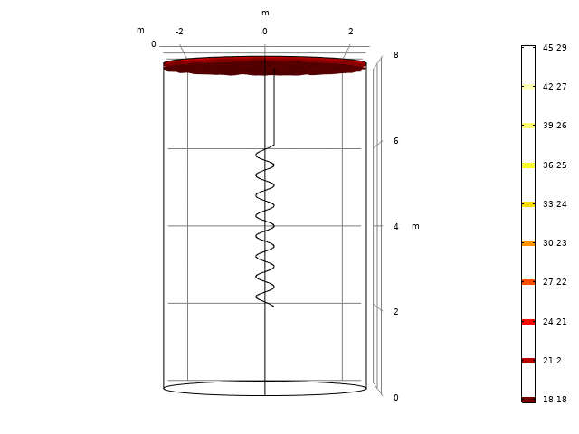
Spiral pitch – isothermal contours
Figure and animation presents how the heat is dissipated over time
with time, heat is dissipated further in the ground
Pitch = 0.1m
time 24h
Pitch = 0.5m
time 150h

Slide 11
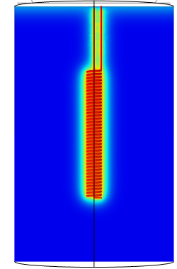
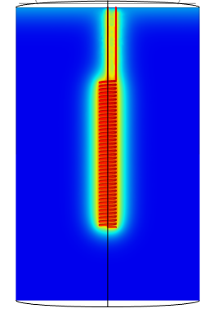
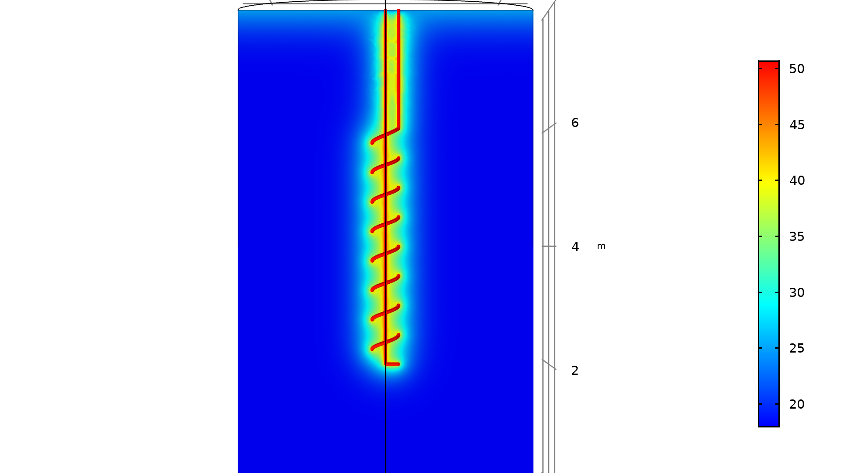
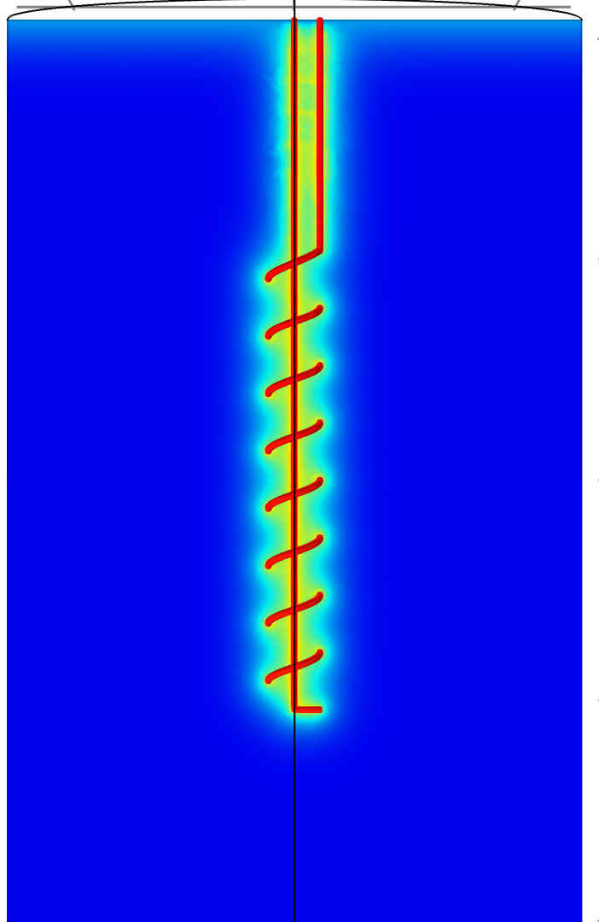
Spiral Pitch – temperature profiles
t=12h
t=24h
t=12h
t=24h
Spiral pitch = 0.1m
Spiral pitch = 0.5m

Slide 12
Case Study in
Cyprus environment

Slide 13
Typical Residential Dwelling in Cyprus
Residential buildings units have decreased in 2008-2016 due to the global economic crisis
Single houses have varied its average area from 202 in 2006 to 279 in 2016.
Data derived from CyStat

Slide 14
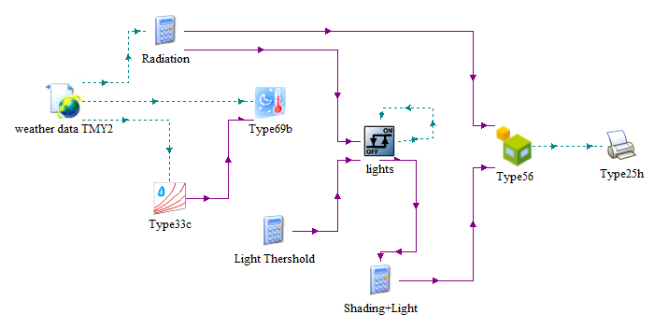
Typical house in Cyprus
The investigated residential building was selected with 260m² area
The Technical characteristics of the Zero Energy Building was selected, such as 0.4W/m²K U-value of external walls and ceiling and 2.25W/m²K on doors and windows.
TRNSYS was used to calculate the heating and cooling loads
Heating and cooling peak values are 3kW and 7kW respectively

Slide 15
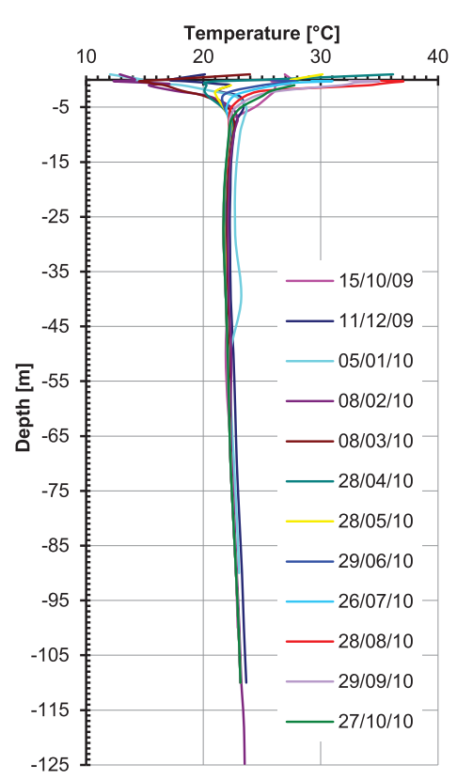
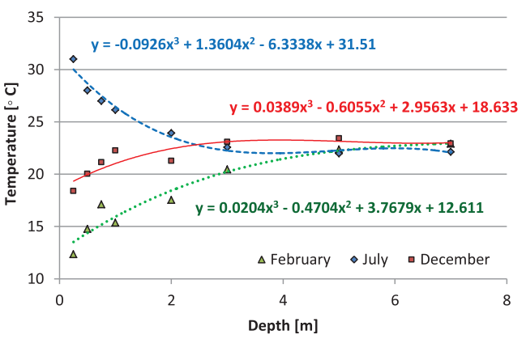
Ground temperatures
At 1m depth, temperature varies with the ambient temperature
At 2-5 meters depth, ground temperature depends on the season
At a depth below 7m the ground temperature is steady at 22.7°C

Slide 16
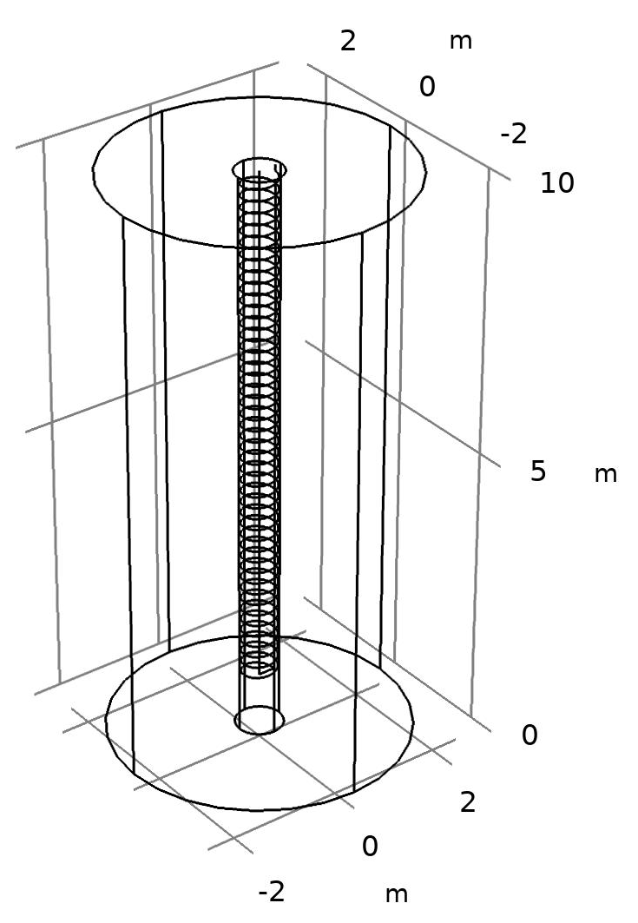
Energy Pile in Lakatamia, Cyprus case study
outlet
inlet
Boundary Conditions
Open boundary on the far field with ground temperature
Thermal Insulation on the top surface; contact with house
Volume flow rate: 15 l/min
Geometry description
Pile depth: 10m
Helic/spiral coil depth: 9m
Spiral coil radius: 0.3m
Spiral axial pitch: 0.1m
Domain diameter: 5m
Spiral pitch
pile
 | Thermal conductivity (W/mK) | Density (kg/m³) | Heat capacity at constant pressure (J/kg K)
Soil | 1.4 | 2300 | 950
Reinforced concrete | 1.628 | 2500 | 837

Slide 17
Energy pile results
Winter month:
Outlet temperature close to steady
Maximum temperature difference: 4°C
Summer Month:
Ground Temperature and outlet temperature increases over time
During the peak summer month the GHE does not achieve a close to steady temperature output
Maximum Temperature difference of 11°C
System could take partial load
February
July

Slide 18
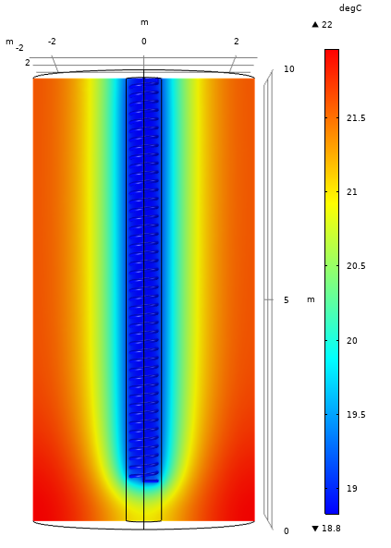
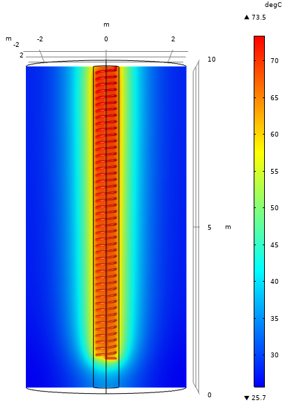
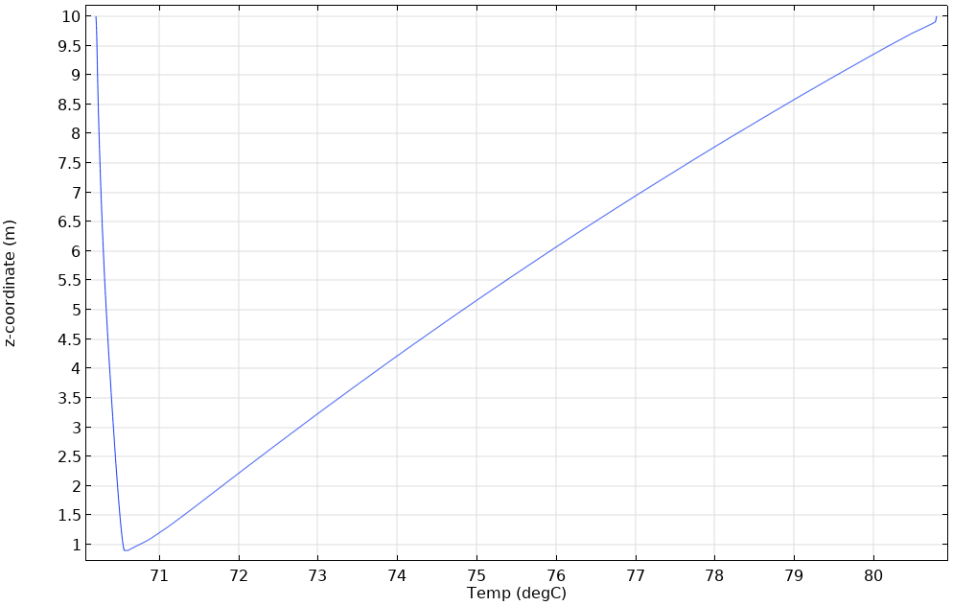
Energy Pile Temperature profiles
In both cases:
Temperature in the far field, at a radius of 2.5 m is affecting the near ground temperature
Energy piles closer than 5m would interfere with each other
A bigger domain should be investigated in order to determine the far field temperature distribution
Temperature profile end of Feb
Temperature profile end of July
Temperature along the length of the pipe

Slide 19
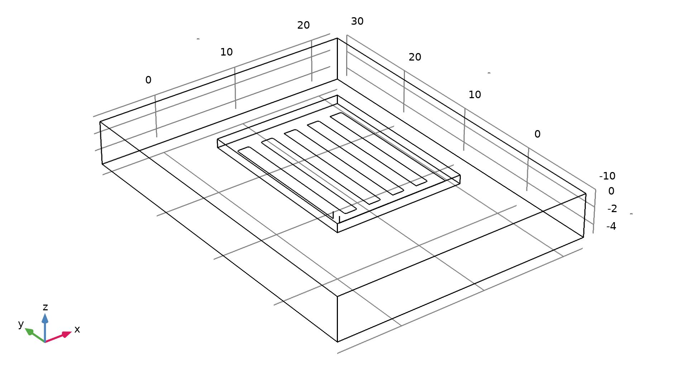
Foundation bed GHE
Geometry is based on the House foundation bed
  Snail configuration of the pipes is used
  Ground temperature is based on the previous seen temperature
Initial Results indicate steady performance of the system
The temperature contact with house does not drop dramatically and is stable
ground
foundation bed
pipes
Results at constant power 3kW

Slide 20
Environmental Impact of GHEs
Lice Cycle Analysis (LCA) investigates the potential environmental impact by evaluating all the input and output material and processes for single or multiple products, processes and services.
GLD software was initially used to calculate the pipe/borehole/trench lengths at the investigated case study
OpenLCA software with Ecoinvent 3.6 database and methods with educational license was employed
the Cut-Off system method is used
Life Cycle Impact Assessment (LCIA) was calculated using both the CML2001 method and the Eco-Indicator99 method
Life Cycle Analysis
(LCA)
Raw Materials
Material Processing
Manufactureing
Distribution
Usage
End of Life
recycle
disposal
reuse
Life Cycle Inventory (LCI)
Vertical type | Pipe length, m (weight, kg) | Borehole / Trench length, m (grout weight, kg) | Land area, m²
U-tube | 2363.40 (670.25) | 131.30 (71940.31) | 144.00
Double U-tube | 4514.40 (2559.64) | 125.40 (68683.85) | 144.00
Coaxial | 1251.30 (7218.46) | 139.00 (76164.58) | 144.00
Horizontal type
Single | 1876.00 (531.94) | 1876.00 | 938.00
Double | 2545.00 (721.63) | 1272.00 | 636.25
Triple | 3066.70 (869.56) | 1022.20 | 511.10
Slinky | 5233.40 (1483.92) | 390.30 | 355.17
Spiral | 5452.00 (1545.9) | 406.50 | 203.25

Slide 21
LCIA results for different GHEs
Operation process has the longest duration (15 years) therefore it is the highest impact in all cases
Operation time represents the 83% of the total impact
ASHP system produces the highest impact using both methods
LCIA results using CML2001 for Global Warming Potential
LCIA results using Eco-Indicator99 for climate change category

Slide 22
Summary and Future Work
Finite Element Method is used to validate computational model against experimental results
COMSOL Multiphysics v5.5 is used with results in good agreement with the experimental
Spiral pitch was varied to investigate the effect on the outlet temperature
  Heat Transfer Rate decreases with the increase of spiral pitch
  Outlet temperature increases with the increase of pitch
  On long term simulations, difference of the spiral pitch with outlet temperature decreases
Typical residential building is investigated in Cyprus
A CFD model was modified to match heating and cooling loads from a Zero Energy Building in Cyprus
Energy pile and foundation bed was computationally investigated with initial results showing a steady performance of the systems
Environmental impact of various GHEs was investigated with coaxial type having the highest impact

Slide 23
Future Work
Future work
  Further examine the energy piles and the foundation bed as a GHE with parametric analysis
  Parameters to be investigated such as:
    Pipe diameter
    Pipe length (spiral length)
    Multilayer ground and present of ground water
    and varied thermal conductivity of the reinforced concrete

Slide 24

Thank you for your attention

