Slide 1
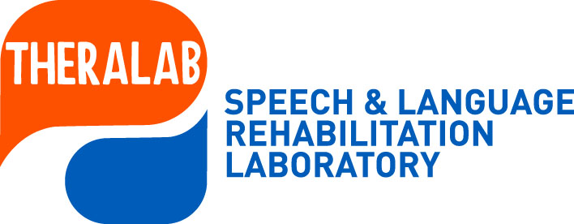
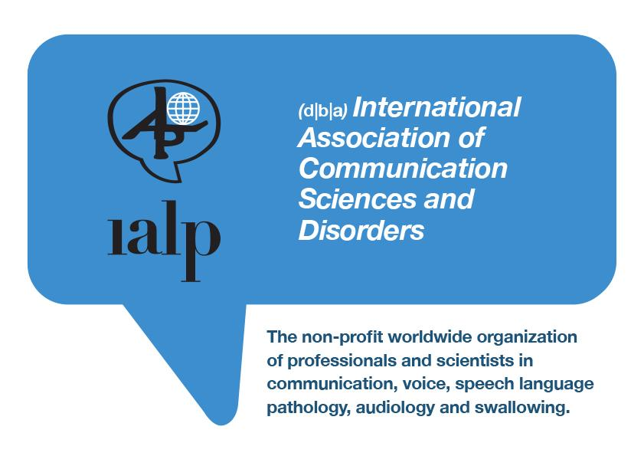


Kakia Petinou, Theodora Papastefanou
Cyprus University of Technology
School of Health Sciences
Department of Rehabilitation Sciences
Speech Sound Disorders: Phonological inconsistency in ASD and TD children
33 WORLD CONGRESS OF THE IALP MALTA 2025, ISHLA, ASD STANDING COMMITTEE IALP
Notes:
Thank you very much for accepting our study on targeting speech intelligibility using phonologically similar targets: a single-case study of dialectal Cypriot-Greek-speaking child with speech sound disorders.

Slide 2
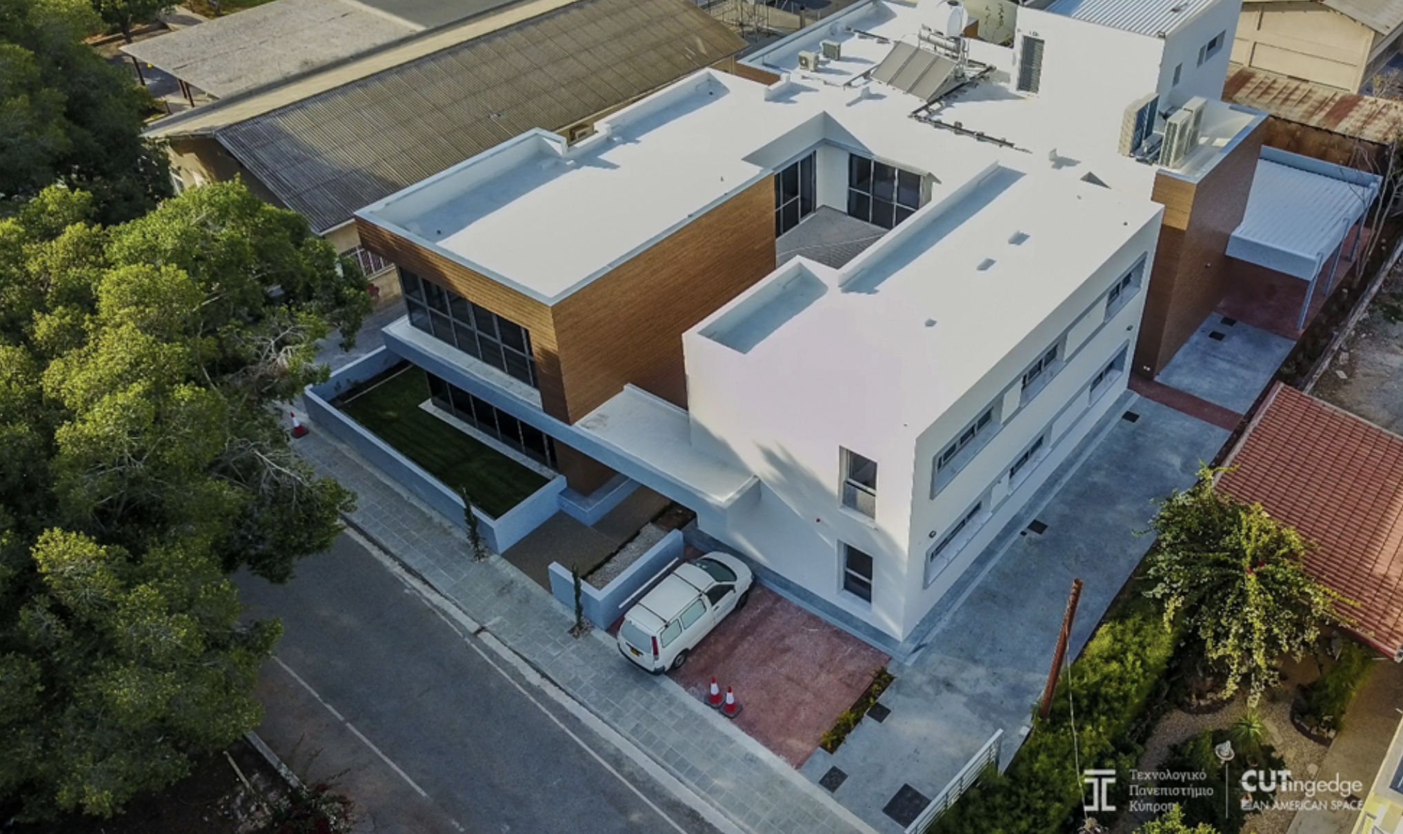

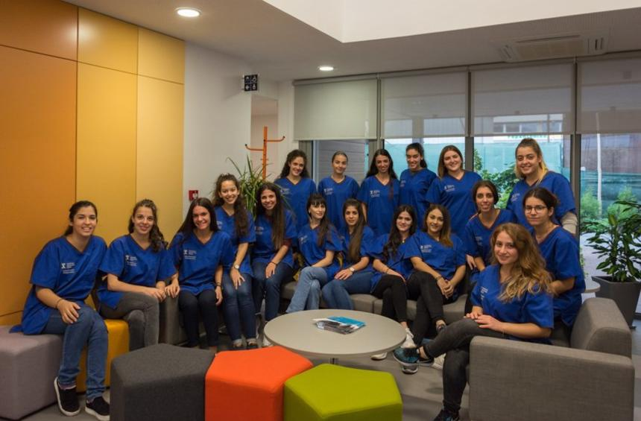
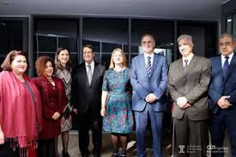
University rehabilitation clinic and research laboratories

Slide 3

Umbrella research project
LINGUISTIC OUTCOMES GROWTH OF SPEECH [LOGOS]
Funding secured 200,000 EURO (2013-2022)
Linguistic Outcomes & Growth Of Speech (LOGOS)-sub projects
Assessing Parameters Expressive Communication Targets ASPECT
Promoting Articulatory Motor Expression Tx PAME
Τesting Of Phonological Skills TOPS
Gainng Articulatory Motor Expression GAME
Gaining Articulatory Intelligibilty GAIN
Transdiagnostic Speech Expression TRASE
Profiling Early Diagnostic Indexes PEDI

Slide 4
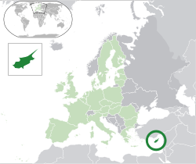
Cyprus Discrete Bilectalism (Rowe & Grohmann, 2013)
Cypriot Greek (CG) as a dialectal variety of Standard Modern Greek (SMG) :
Mainly spoken in Cyprus
Discreet Bilectal (Rowe & Grohmann, 2013)
Notes:
The linguistic variety investigated in this study is CG, a variety of Standard Modern Greek (SMG) [39,40]. Although CG is the everyday variety used by most speakers on the island of Cyprus, SMG is used in specific official settings such as school classes and the media. At the same time, CG dominates in informal everyday communication. The Greek-speaking populace of Cyprus is diglossic in that CG is the vernacular form (low variety) used in everyday communication, whereas SMG (as the high variety) is used in educational settings, government bodies, and the media. Recent reports propose the emergence of a dialectical continuum of CG with an emerging "Koine" or "Urban" form of CG [41]. Its consonantal phonetic inventory contains 31 singletons, most of which have geminate counterparts. There are bilabial, labio-dental, dental/alveolar, palatal and velar phonemes. Regarding manner of articulation, there are stops, fricatives, affricates, nasals, liquids, and glides. The liquid segment /r/ is trilled. In CG, voiced stops are pre-nasalized, with voiceless cognates being either unreleased or aspirated. The /n/ and /s/ may also occur in the word-final position. CG contains post-alveolar fricative and affricates and geminates (double segments) differing from singletons mainly in duration (Armostis, 2009).

Slide 5
Speech Sound Disorders (SSD)
Definition: SSDs involve difficulties in producing speech sounds correctly, affecting speech intelligibility.
A prevalent disorder in children
Overall Prevalence: Approximately 20%
From this 4% CAS, 10% Inconsistent Phonological Disorder IPD, 6% Articulation (Dodd et al., 2014; Ttofari et al., 2022).
Notes:
SSDs involve difficulties in producing speech sounds correctly, affecting speech intelligibility.
Common in early childhood, affects communication, social skills, and academic performance

Slide 6
SSD in ASD
ASD Prevalence: Approximately 20%-40% of 4-6 year-olds with ASD present with SSD (Kjellmer L, et al., 2018; Shriberg et al., 2019)
Diverse profiles with CAS characteristics very common
Phonological Disorders also common (Petinou, 2022)
Notes:
SSDs involve difficulties in producing speech sounds correctly, affecting speech intelligibility.
Common in early childhood, affects communication, social skills, and academic performance

Slide 7
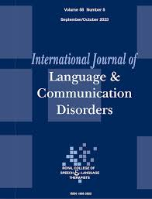
MY POINT OF FOCUS -Inconsistency
Coined by Dodd DEAP Test
Accuracy of Different production of same target across trails
Clinical marker in differential diagnosis
Points to taxonomy
Production accuracy allows identification of SSD
Guides clinical management (assessment and intervention)
Petinou-Loizou K, Ttofari K, Filippou E. What is in a name: Taxonomy of speech sound disorders from a cross-linguistic perspective. Int J Lang Commun Disord. 2024 Nov-Dec;59(6):2123-2130. doi: 10.1111/1460-6984.13092. Epub 2024 Jul 19. PMID: 39031175.
Notes:
Therefore, SSD affects a child's ability to produce sounds correctly. Phonological intervention is key in addressing speech sound errors.
Importance of phonological density and word-level characteristics in intervention. Significance of Study: Limited studies on Cypriot Greek-speaking children with SSD. Exploring the role of phonological error types via inconsistency, given that Dodd’s model, adopted here, includes two subtypes of Phonological Disorders differentiated on the presence or absence of phonological inconsistency.

Slide 8
Inconsistency Facts
TD children ages 3-5 years show inconsistency close to 20%
SSD inconsistency approximately 60% to 70%
Crosslinguistic studies (Dodd et al., 2024)
Cut-off point more than 40% inconsistency needs clinical attention
Inconsistency prevalent in CAS (70%) and IPD (58%) profiles SSD inconsistency approximately 60% to 70%
Notes:
Therefore, SSD affects a child's ability to produce sounds correctly. Phonological intervention is key in addressing speech sound errors.
Importance of phonological density and word-level characteristics in intervention. Significance of Study: Limited studies on Cypriot Greek-speaking children with SSD. Exploring the role of phonological error types via inconsistency, given that Dodd’s model, adopted here, includes two subtypes of Phonological Disorders differentiated on the presence or absence of phonological inconsistency.

Slide 9
Differential Diagnostic Classification System (DDCS) categorizes Speech Sound Disorders (SSDs)
Articulation disorder
  Errors on producing single sounds
Phonological Delay:
  A delay compared to typical developmental milestones, but they are still using typical phonological processes.
Consistent Deviant Phonological Disorder:
  The use of non-developmental or atypical phonological processes, indicating an impaired understanding of the target phonological system.
Inconsistent Deviant Phonological Disorder:
  Variable productions of the same word, with some productions being more accurate than others, and the use of inconsistent phonological processes.
Childhood Apraxia of Speech (CAS):
  Motor speech disorder in planning and coordinating the complex movements needed for speech (inconsistency plus prosodic and pause features)
Notes:
Dodd's 2014 Differential Diagnostic Classification System (DDCS) categorizes Speech Sound Disorders (SSDs) into several subtypes, including articulation disorder, phonological delay, consistent deviant phonological disorder, inconsistent deviant phonological disorder, and Childhood Apraxia of Speech (CAS). This system is based on a psycholinguistic model of speech production and provides a framework for understanding the different ways in which children can experience SSDs. ) Dodd, B. Differential Diagnosis of Pediatric Speech Sound Disorder. Curr Dev Disord Rep 1, 189–196 (2014). https://doi.org/10.1007/s40474-014-0017-3

Slide 10
The current study
The aim was twofold:
  (a) to measure the presence of inconsistency in children with SSD/ASD
  (b) to map error patterns
Exploratory examination-pilot
Hypothesized that children with ASD/SSD would exhibit more inconsistency as compared to their TD counterparts
Did not explore the source of the challenges (linguistic versus motor)
  Linguistic – accessing lexical representations
  Motor programming – accessing the articulatory structure of words
Levellt’s speech production model (1999)

Slide 11
Participants
Participants included 14 bilectal CG-speaking children
ASD: 7 Boys (M= 6.7; SD = 1.11)
TD: 5 boys and 2 girls (M= 6.3, SD= 1.06)

Slide 12
Participants [2]
Recruited from several SLP centers and the CUT rehabilitation Clinic
Some children were enrolled in therapy (no more than 2 months before the onset of the study)
Caregivers signed a written consent (Cyprus National Bioethics Committee Approval, 2021, Protocol number 41).

Slide 13
Participants [3]
SSD diagnosis was performed via the Cyprus Phonology Test (Petinou in progress, 2025).
Intelligibility Context Scale-Greek (average number 1-2)
Phonological Deficits:
  Limited phonetic inventory, difficulties with consonant clusters, and vowel production errors.
  Impaired intelligibility and sound substitution patterns

Slide 14
Methodology and Procedures
Inconsistency was examined with the use of a 40-word probe list consisting of trisyllabic and multisyllabic targets
The stimuli were designed according to Dodd’s DEAP test (Personal Communication).
Converted to PowerPoint pictures
Targets were elicited three times across one experimental session
Blocks of trials were presented randomly, with a time delay between each block presentation

Slide 15
Methodology and Procedures [2]
Productions were transcribed in IPA and were coded using a binary system
0 = no inconsistency, 1 = presence of inconsistency (variable productions across at least two out of the three times)
Coding and measurement reliability across 10% of the productions was approximately 90%

Slide 16

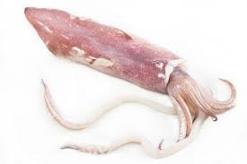

Stimuli - Example
/kala’maɾi/
‘squid’
/kala’Θaci/
‘basket/
/kala’maci/
‘straw’

Slide 17
Examples Cognate stimuli 3-syllables; multisyllabic
Probe | 1 | 2 | 3 | SCORE
[kaˈmila] | [aˈmila] | [gaˈmila] | [laˈmila] | 1
[doˈmata] | [moˈmata] | [maˈmata] | [kaˈmata] | 1
[baˈnana] | [na'nana], | [naˈnana] | [naˈnana] | 0
[kanguˈro] | [atoˈro] | [tantuˈro] | [anguˈro] | 1
[ˈp:it:a] | [ˈita] | [ˈmita] | [ˈtita] | 1

Slide 18
Results [1] Group Comparison – Inconsistency Scores
Group | Mean (%) | SD | Min–Max
ASD/SSD (n=7) | 66.5 | 20 | 38–96
TD (n=7) | 3 | 1 | 0–8
Statistical Test: Mann-Whitney U = 49, p < 0.01 9(Significant)
Scores differed significantly between the ASD group (median = 0.64, IQR 0.56–0.78) and the TD group (median = 0.00, IQR 0.00–0.0625) as determined by a two-tailed Mann–Whitney U test (U = 49.0, p = 0.0019). The ASD group exhibited consistently higher values.
Notes:
Interpretation
Children with ASD/SSD show substantially higher and more variable inconsistency compared to their typically developing (TD) peers.
This supports the study’s hypothesis that inconsistency is a key marker in distinguishing SSD subtypes, particularly those with inconsistent phonological disorder (IPD) or planning deficits (e.g., CAS). A Mann–Whitney U test was conducted to compare [dependent variable, e.g., "scores"] between the ASD group (Mdn = 0.64) and the TD group (Mdn = 0.00). Results indicated a significant difference between groups, U = 49.00, p = .0019, suggesting that ASD scores were significantly higher than TD scores
The Mann-Whitney result is statistically significant (p < 0.001), confirming that children with SSD exhibit significantly higher inconsistency in speech production than their typically developing peers. This supports the diagnostic relevance of inconsistency measures.
Children with SSD (n=9) showed significantly higher inconsistency (M = 70.5%) than TD peers (M = 1.9%, p < 0.001).
Despite the small sample size, the effect is strong and statistically robust. Inconsistency appears to be a key marker in distinguishing SSD subtypes.
Dodd's 2014 Differential Diagnostic Classification System (DDCS) categorizes Speech Sound Disorders (SSDs) into several subtypes, including articulation disorder, phonological delay, consistent deviant phonological disorder, inconsistent deviant phonological disorder, and Childhood Apraxia of Speech (CAS). This system is based on a psycholinguistic model of speech production and provides a framework for understanding the different ways in which children can experience SSDs.

Slide 19
Figure 1
Notes:
Interpretation
Children with Speech Sound Disorders (SSD) show substantially higher and more variable inconsistency compared to their typically developing (TD) peers.
This supports the study’s hypothesis that inconsistency is a key marker in distinguishing SSD subtypes, particularly those with inconsistent phonological disorder (IPD) or planning deficits (e.g., CAS).
The Mann-Whitney result is statistically significant (p < 0.001), confirming that children with SSD exhibit significantly higher inconsistency in speech production than their typically developing peers. This supports the diagnostic relevance of inconsistency measures.
Children with SSD (n=9) showed significantly higher inconsistency (M = 70.5%) than TD peers (M = 1.9%, p < 0.001).
Despite the small sample size, the effect is strong and statistically robust. Inconsistency appears to be a key marker in distinguishing SSD subtypes.
Dodd's 2014 Differential Diagnostic Classification System (DDCS) categorizes Speech Sound Disorders (SSDs) into several subtypes, including articulation disorder, phonological delay, consistent deviant phonological disorder, inconsistent deviant phonological disorder, and Childhood Apraxia of Speech (CAS). This system is based on a psycholinguistic model of speech production and provides a framework for understanding the different ways in which children can experience SSDs.

Slide 20
Results [2] Qualitative Error Patterns (ASD/SSD Group)
Variable Productions (IPD hallmark)
Backing (e.g., /t/ → /k/) → Severe in MIX
Vowel Assimilations → [to'mata] → [ta'mata]
Syllable Simplification → Cluster and structure omissions
Regressive assimilation such as [to'mata] → [mo 'mata]
Initial consonant deletion such as [ba'nana] → [a'nana]
Stress Shifts → Suggesting motor planning issues
Notes:
Dodd's 2014 Differential Diagnostic Classification System (DDCS) categorizes Speech Sound Disorders (SSDs) into several subtypes, including articulation disorder, phonological delay, consistent deviant phonological disorder, inconsistent deviant phonological disorder, and Childhood Apraxia of Speech (CAS). This system is based on a psycholinguistic model of speech production and provides a framework for understanding the different ways in which children can experience SSDs.

Slide 21
Diagnostic Implications
Based on DDCS Taxonomy:
ASD/SSD children might present with Inconsistent Phonological Disorder (IPD)
ASD/SSD may present with Features consistent with Child Apraxia of Speech (CAS)
Such features need to be taken into account in a detailed taxonomic fashion during diagnosis, differential diagnosis and intervention planning
Notes:
Dodd's 2014 Differential Diagnostic Classification System (DDCS) categorizes Speech Sound Disorders (SSDs) into several subtypes, including articulation disorder, phonological delay, consistent deviant phonological disorder, inconsistent deviant phonological disorder, and Childhood Apraxia of Speech (CAS). This system is based on a psycholinguistic model of speech production and provides a framework for understanding the different ways in which children can experience SSDs.

Slide 22
Overall findings
The results suggested that inconsistency might be a core speech characteristic in ASD and needs to be assessed as a distinct profile
TD children and those with IPD had different quantitative and qualitative error profiles, confirming IPD as a diagnostic category of SSD.
Variable characteristics in terms of CAS versus IPD taxonomy
Align with Dodd’s framework that atypical, variable errors are diagnostic markers for planning/programming impairments
Words with more phonemes, syllables, and consonant clusters were vulnerable to inconsistency, but their frequency of occurrence had no effect
Within the SSD category, children with suspected planning/programming deficits (CAS) presented with more vowel assimilations and stress shift across productions
Notes:
Dodd's 2014 Differential Diagnostic Classification System (DDCS) categorizes Speech Sound Disorders (SSDs) into several subtypes, including articulation disorder, phonological delay, consistent deviant phonological disorder, inconsistent deviant phonological disorder, and Childhood Apraxia of Speech (CAS). This system is based on a psycholinguistic model of speech production and provides a framework for understanding the different ways in which children can experience SSDs.

Slide 23
Future directions
Does inconsistency decrease after intervention with therapy?
Does it differentiate SSD subtypes?
What are the most vulnerable words? (specificity and sensitivity)
How does inconsistency correlate with connected speech and ICS?
How does it surface cross-linguistically?
Similar sounding words across languages

Slide 24


Slide 25
Results
.

Slide 26
Differential Diagnostic Classification System (DDCS) categorizes Speech Sound Disorders (SSDs) [2]
To cite this article: Barbara Dodd, Beth McIntosh, Sharon Crosbie & Alison Holm (2024) Diagnosing inconsistent phonological disorder: quantitative and qualitative measures, Clinical Linguistics & Phonetics, 38:5, 453-476, DOI: 10.1080/02699206.2023.2224916
Assessment determined the proportions of words said consistently (i.e. the same across productions: all correct or with the same error) or inconsistently (i.e. differently across productions: at least one correct and one error or different errors in productions). Qualitative analyses examined error types and explored the effect of target words’ characteristics on inconsistency. Children with IPD produced 52% of words with different errors. While 56% of all phoneme errors were developmental (age appropriate or delayed), atypical errors typified inconsistency: default sounds and word structure errors. Words with more phonemes, syllables and consonant clusters were vulnerable to inconsistency, but their frequency of occurrence had no effect
TD children and those with IPD had different quantitative and qualitative error profiles, confirming IPD as a diagnostic category of SSD. Qualitative analyses supported the hypothesised deficit in phonological planning of words’ production for children with IPD.
Notes:
Dodd's 2014 Differential Diagnostic Classification System (DDCS) categorizes Speech Sound Disorders (SSDs) into several subtypes, including articulation disorder, phonological delay, consistent deviant phonological disorder, inconsistent deviant phonological disorder, and Childhood Apraxia of Speech (CAS). This system is based on a psycholinguistic model of speech production and provides a framework for understanding the different ways in which children can experience SSDs.

